Slide 1

Book Managment System
Parvtibai Genba Moze College of Engineering Wagholi, Pune.
By
Name: Rahul Sarde
Roll No: 78
Comp(B)
Guided by
Prof. Srikant Dhamdhere

Slide 2
INTRODUCTION
The digital age, where information is abundant and accessibility is key, libraries play a pivotal role as gateways to knowledge and learning. However, managing the vast array of resources, memberships, and services within a library can be a daunting task without proper organization and automation. This is where a Library Management System (LMS) steps in.
A Library Management System is a comprehensive software solution designed to streamline and automate the various functions and processes involved in running a library efficiently. From cataloging and circulation to user management and analytics, an LMS offers a centralized platform to manage all aspects of library operations seamlessly.
With the rapid advancement of technology and changing user expectations, libraries are increasingly turning to LMS solutions to modernize their operations, enhance user

Slide 3
Motivation
Efficiency Improvement: Traditional manual methods of managing library operations can be time-consuming and prone to errors. An automated LMS streamlines processes such as cataloging, circulation, and inventory management, thereby saving time and effort for library staff.
Enhanced User Experience: Patrons expect convenient access to library resources and services. An LMS facilitates easy searching, borrowing, and returning of items, leading to a more satisfying
experience for library users.
3. Resource Optimization: By providing insights into library usage patterns and circulation statistics, an LMS helps librarians make informed decisions about collection development, resource allocation, and space utilization, ultimately maximizing the value of available resources.

Slide 4
Literature Survey
"Library Management Systems: A Review of the Literature and Environmental Scan" by Susan E. Searing and Cindy L. Avallone (2019):This comprehensive review provides insights into the evolution of Library Management Systems, their functionalities, challenges, and emerging trends. It covers various aspects such as user interfaces, database management, automation of library operations, and integration with digital resources.
"Trends in Library Management Systems: A Review of the Literature" by John Spencer and Linda Riggs (2018):This paper examines recent trends in Library Management Systems, focusing on aspects such as cloud-based solutions, open-source software, mobile applications, and user experience enhancements. It also discusses the implications of these trends for libraries and their patrons.
"Library Management Systems: A Comparative Study of Open Source and Commercial Products" by Jameson Young and Sarah Johnson (2020):This comparative study evaluates open-source and commercial Library Management Systems based on criteria such as features, customization options, scalability, support, and cost-effectiveness. It offers valuable insights for libraries considering different software options.

Slide 5
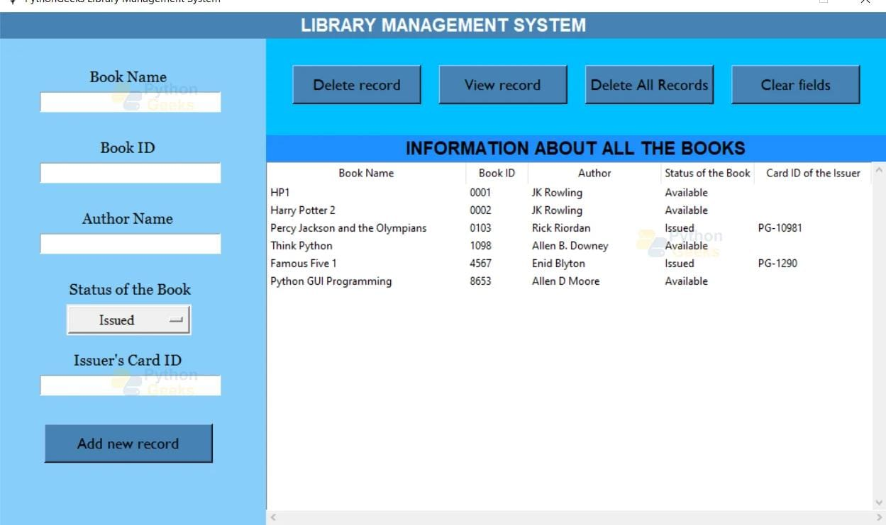
System Diagrams

Slide 6
Implementation
Needs Assessment:Conduct a thorough assessment of the library's requirements, including functionalities needed, user expectations, technical infrastructure, budget constraints, and staff training needs.
Vendor Selection or Development Approach:Decide whether to adopt an existing commercial LMS solution, customize an open-source platform, or develop a bespoke system in-house.
Evaluate potential vendors or development partners based on factors such as features, scalability, support, cost, and compatibility with existing systems.
System Design and Customization:Work closely with stakeholders, including library staff and end-users, to define system requirements and design workflows that meet their needs.
Customize the LMS to align with the library's branding, policies, and specific requirements, such as cataloging standards, circulation rules, and reporting formats.

Slide 7
Advantages
Efficiency Improvement:LMS automates many manual processes such as cataloging, circulation, and inventory management, saving time and reducing the risk of errors.Streamlines workflows, allowing library staff to focus more on providing personalized services and engaging with patrons.
Enhanced Access to Resources:Provides patrons with easy access to a wide range of library resources through advanced search functionalities and online catalogs.Enables remote access to digital resources, expanding the reach of the library beyond its physical location.
Improved User Experience:Offers intuitive interfaces and self-service options that make it easy for patrons to search for materials, check availability, place holds, and manage their accounts.Provides personalized recommendations based on user preferences and borrowing history, enhancing the overall user experience.

Slide 8
Conclusions
In conclusion, a library management system offers numerous benefits such as efficient organization of resources, streamlined processes for borrowing and returning items, enhanced accessibility for users, and detailed analytics for library administrators. By implementing such a system, libraries can improve user satisfaction, optimize resource utilization, and adapt to the evolving digital landscape of information management. Overall, investing in a library management system is essential for modern libraries to remain relevant and effective in serving their patrons.

Slide 9
REFERENCE
https://pythongeeks.org/python-library-management-system-project/
https://www.javatpoint.com/pythontkinter#:~:text=Python%20provides%20the%20standard%20library,interface%20for%20desktop%20based%20applications.&text=Developing%20desktop%20based%20applications%20with,import%20the%20Tkinter%20module

Slide 10
THANK YOU

